Slide 1
Company Presentation ETW
Lecture proposal for convention in November

Slide 2
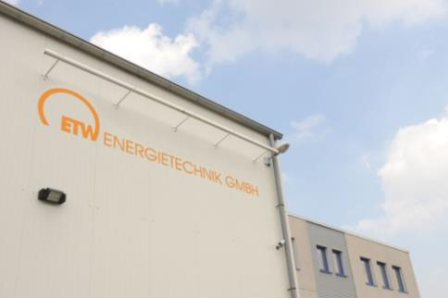
Company.
Competence in the private sector.
More than 30 years experience with industrial scale CHP plant realization and service.
CHP units for natural gas or other gaseous fueles (farm biogas, landfill gas, sewage gas, mine gas, etc.)
Power range 400kW – 4,5MW el. / Module

Slide 3
Company.
Company Formation: | 1996
Implemented projects: | > 500
Installed Gas-CHP capacity: | > 288 MW
Total Turn-over 2018: | > 30 million €
International sales: | 40%
Employees: | 100
Engineering/Plant design: | 15
Manufacturing: | 25
Service: | 50
Sales & Adminsitartion: | 10

Slide 4
History.
1st large scale Industrial CHP Plant
25 Emploee
Sales 10 Mio €
Factory doubling
1995
2000
2007
2014
1996
2005
2009
2018
Takeover Löpke Diesel
ISO 9001
Move to Moers

Slide 5
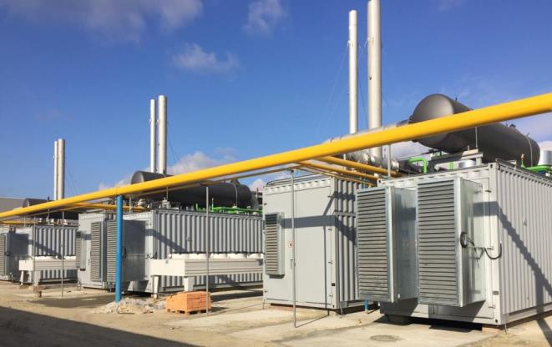
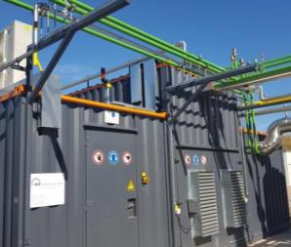
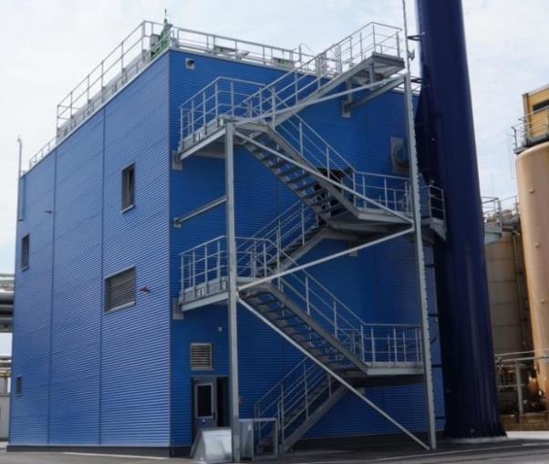
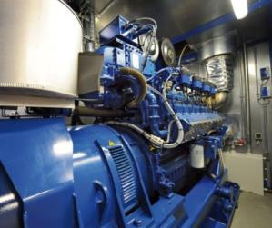
ETW Business areas.
Engineering & Plant Design
Manufacturing
Installation & Commissioning
Maintenance & Spare Parts
Container Units
Biogas to Grid
Industrial CHP Plants
Service

Slide 6
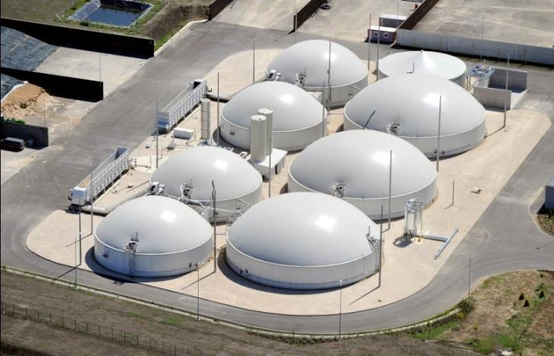
References. Biogas CHP.
BGA Szarvas (Hungary). ETW Gas pre-treatment, Flare and 600 kWel

Slide 7
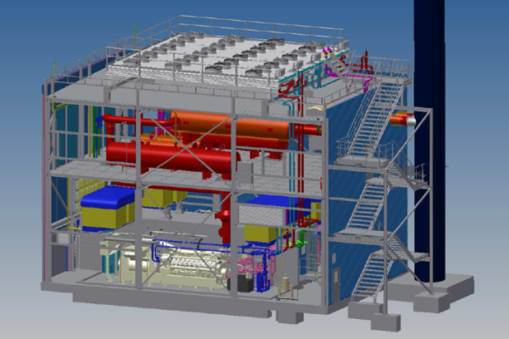
Reference Merck Gernsheim
Industrial standards
Multiple gas solutions
Customized maschine buildings
Large-scale applications

Slide 8
Reference. Merck Gernsheim.
2x CHP Units ETW 2000 EG
Exhaust steam boilers 11barg
Machine House
Sound Enclosures
Ventilation System
6,3kV Switchboard
Chimney
Island Mode Operation

Slide 9
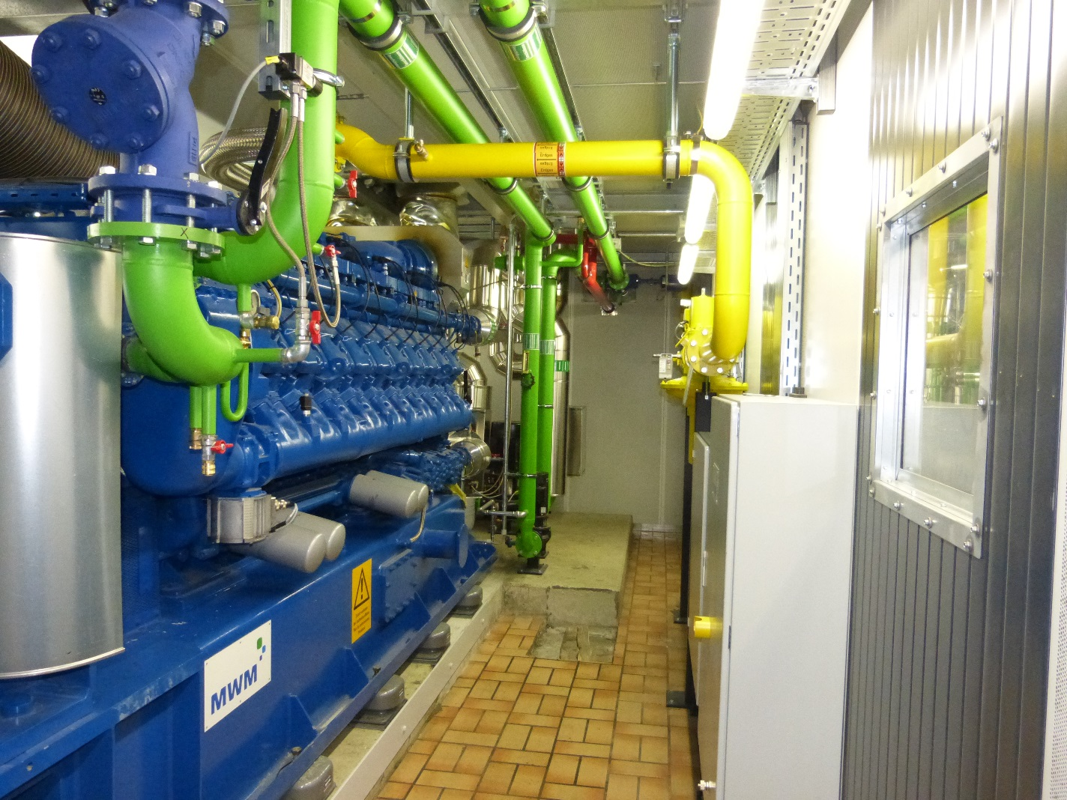
Reference. Stadtwerke Ratingen.
2x CHP Units ETW 2000 EG
Remotorization of existing In-house Installation plant
Heat utilization for district heating in Ratingen, Germany

Slide 10
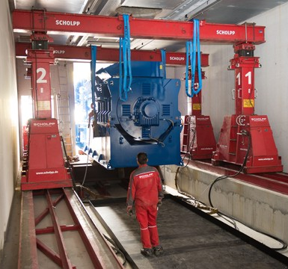
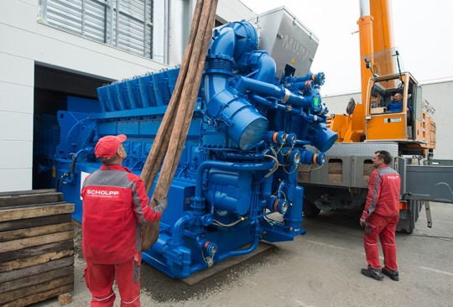
Reference. UMG Göttingen.
4,5MW CHP Plant, Inhouse Installation
Heat Recovery 70 / 120°C
Commissioning December 2017

Slide 11
Reference. APK Kursk Russia.
3x CHP Units ETW 2000 EG.
Generator 10kV
1x Container Unit Power to Heat 1 MW
3x Hybrid boiler, 10 barg, 15t Steam/h

Slide 12
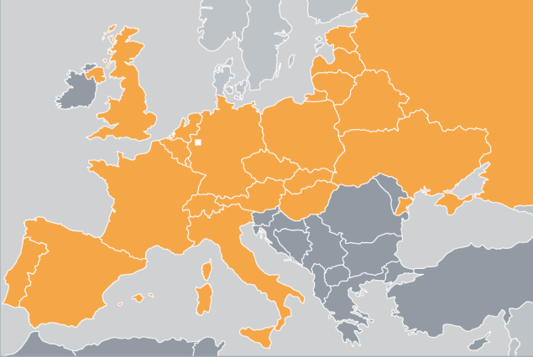
Location and Sales Region.
The Ruhr region, a strategical location:
Industrial area
Population 12 mi
Highly qualified labour
Supply-chain
8 Int. Airports in 3h
Research facilities
ETW Headquarter & Production
Moers, North Rhine-Westfalia, Germany

Slide 13
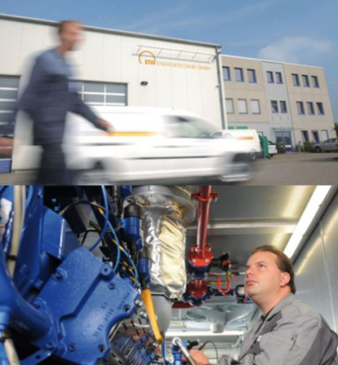
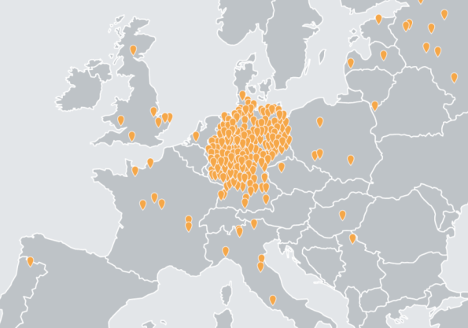
ETW Service.
50 employees in service department, > 200 plants under maintenance
100% availability.

Slide 14
ETW Lecture Proposal
CHP Applications for the industial and private sector
Trigeneration plants including case studies for
cogeneration units with absorption chiller and
cogeneration units with steam boiler and with usage
of thermal oil
- Exhaust emmissions of gas engines and possibilties for
reduction (catalyst)
Service requirements for gas engines and complete cogeneration units
Examples for engines where no sufficiant service has been provided

Slide 15
ETW Energietechnik GmbH Ferdinand-Zeppelin-Straße 19 D - 47445 Moers T +49 2841 9990-0 F +49 2841 9990-199 E info@etw-energie.de
Management: Helmut Weiß, Carsten Weiß, Marco Weiß

