Slide 1
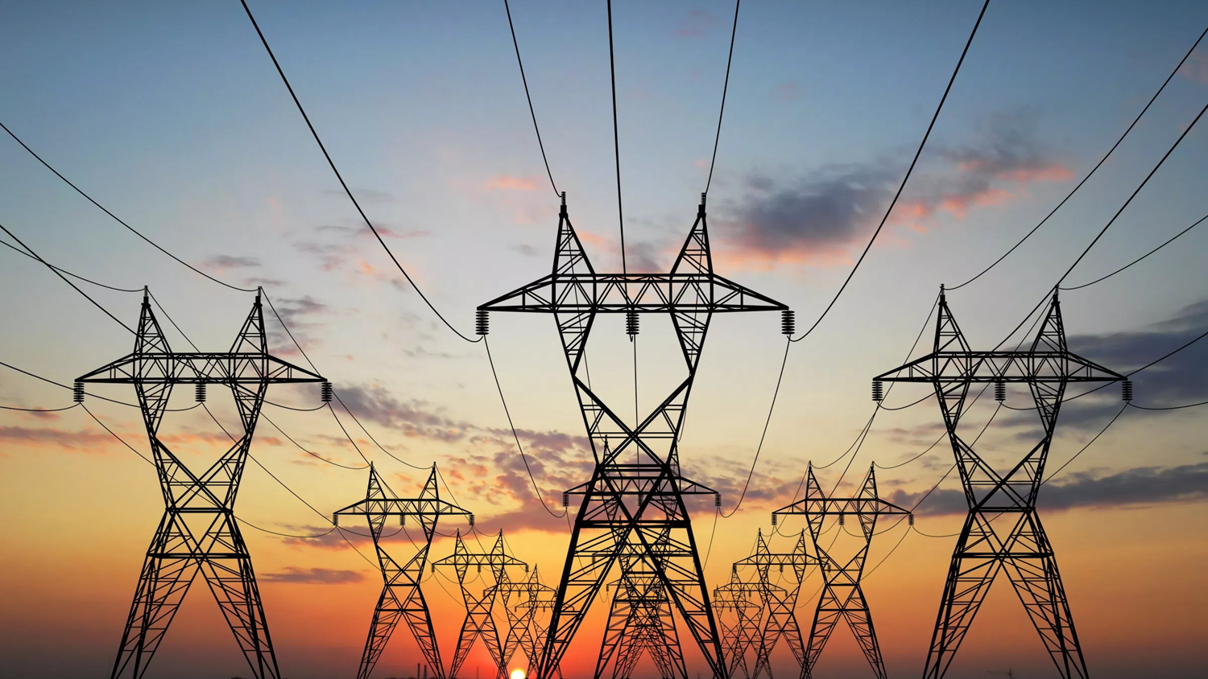
Harmonics:
Problems, sources and mitigation techniques
Claudio Zaffardi

Slide 2
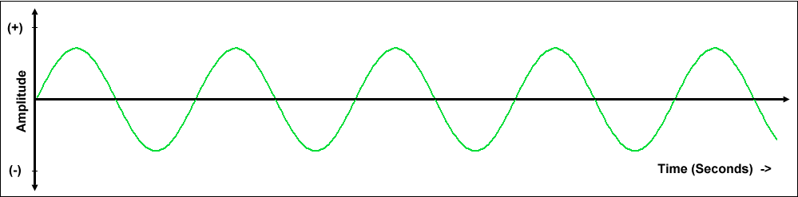
The Ideal Waveform
In public power distribution networks the ideal undistorted AC electrical signal has a typical frequency of 50Hz or 60Hz depending on the country or region.
Due to the method of generation, the signal alternates between proportionally equal, positive and negative values resulting in a pure sinusoidal waveform.
In reality however these signals contain many types of disturbances.

Slide 3
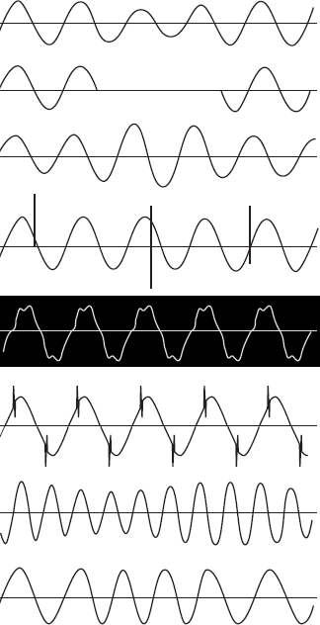
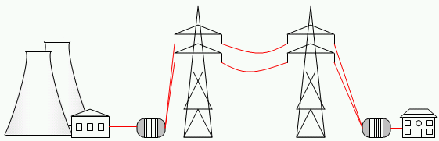
Voltage
dip
The power grid normally experiences huge variations of load and reacts to changes in the voltage waveform.
Causes of power disturbances range from electrical switching circuits to lightning.
Harmonic distortions are repetitive and continuous deformations of the voltage or current waveforms.
All distortions result in deviations from the ideal sinusoidal waveform.
Power
interruption
Voltage
rise
Transient
over-voltage
Harmonic
distortion
Commutation
dips/notches
Voltage
fluctuation
Frequency
fluctuation

Slide 4
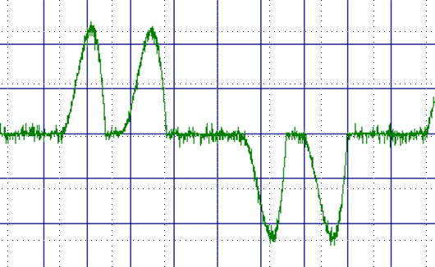
I_{DC}
Non linear loads
a
1
2
3
~
b
~
c
Harmonics are primarily caused by loads that draw current in a non-sinusoidal manner (non linear loads)
~
V_{DC}
4
5
6
All diode rectifier circuits draw non sinusoidal current
Biggest contributors are:
        Switch Mode Power Supplies
        Lighting
        UPS
        AC drives

Slide 5
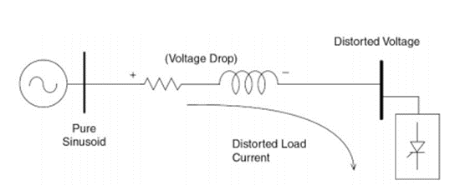
Non-linear Load:
Switch mode power supply,
Electronic lighting, UPS, AC Drives
Voltage Distortion
U=Z*I
Current Distortion
System
Impedance
Harmonic currents flowing through the system impedance create distorted voltage drops, due to the superposition principle it results also in voltage distortion

Slide 6
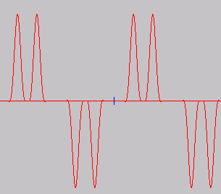
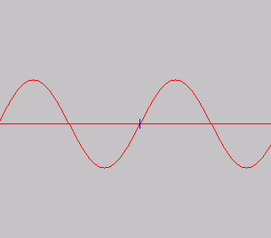
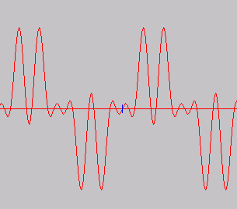
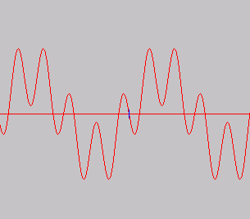

How do they look like
Any periodic signals, independent of shape, can be represented as a sum of sine-waves.
This is called a “Fourier” representation.
That gives the opportunity to treat all signals by AC circuit theory.
1’st (fundamental)
5.th
7.th
11.th
13.th
Harmonics is decomposition of a signal into different (integer of fundamental) frequencies

Slide 7
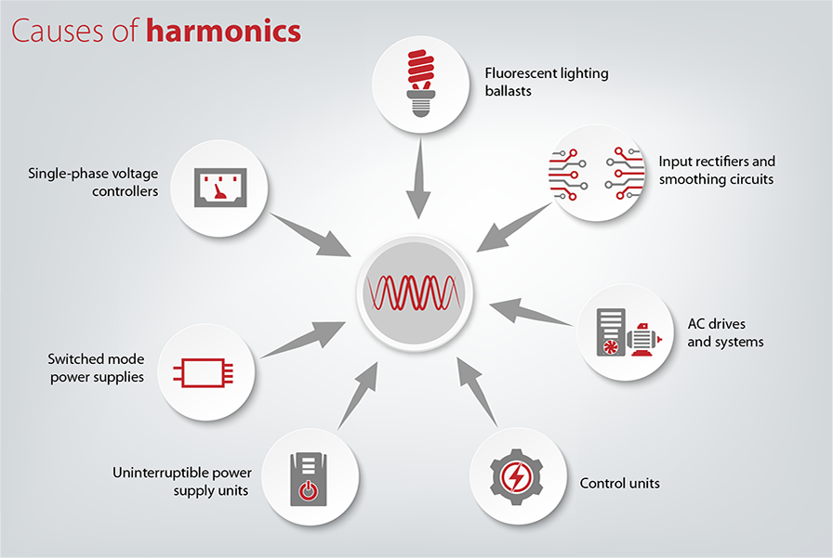
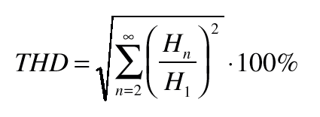
To quantify the produced harmonic level, THD factor is introduced
THD = TOTAL HARMONIC DISTORSION
THD I = Total harmonic current distortion
THD V = Total harmonic voltage distortion
It’s a percentage value that takes into account the weight of each harmonics

Slide 8
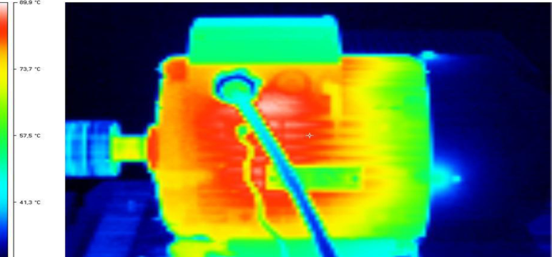
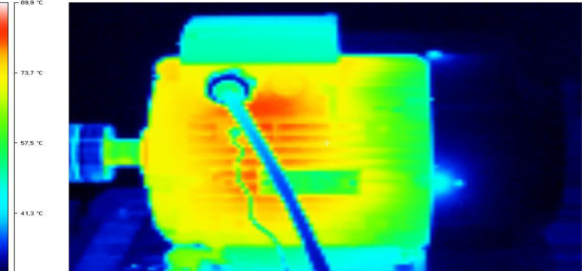
Harmonic effects on the power grid
U_{h} = Z x I_{h}
Harmonics lead to:
Poor utilization of supply infrastructure
Reduced equipment life (premature aging)
Lower equipment efficiencies
Torque ripples in motors
Resonance generation
Increased EMI
Increased likelihood of trips and production stops

Slide 9
What is a Safe Level?
Maximum
distortion level
Immunity level
You can be sure your supply is already polluted with harmonics!
Product immunity has to be higher than system distortion to prevent breakdown but product life is a function of distortion level
Good practice is aiming at system THDv of 5% to avoid issues
5%
8%
10%
Odd harmonics Non-multiple of 3 |  | Odd harmonics Multiple of 3 |  | Even harmonics
Order ‘h’ | Harmonic Voltage (%) | Order ‘h’ | Harmonic Voltage (%) | Order ‘h’ | Harmonic Voltage (%)
5 7 11 13 17 17<h≤49 | 6 5 3.5 3 2 2.27(17/h)-0.27 | 3 9 15 21 21<h≤45 | 5 1.5 0.3 0.2 0.2 | 2 4 6 8 10 10<h≤50 | 2 1 0.5 0.5 0.5 0.25(10/h)+0.25

Slide 10

Fast guidance
Reflect/calculate on harmonics if:
AC Drives load on transformer is >30%
The transformer is >90% loaded
Generator fed supply
If problems occur consider:
Use special drives
Use filter(s)
Change layout of transformer/generator
Mix single and three phased non-linear loads
Do not use mitigation equipment
if not needed.

Slide 11


Slide 12
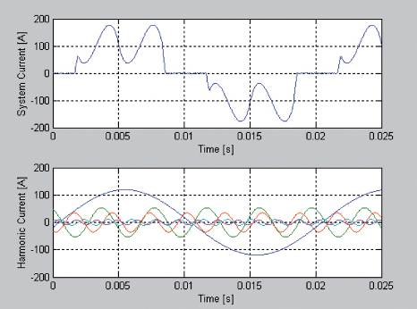
Passive Solutions – DC and AC Inductors
THiD = 30% - 45%
Inductors simply resist CHANGES in current
DC Inductors
They are installed on different sides on the Rectifier
Danfoss
AC Inductors
Vacon

Slide 13
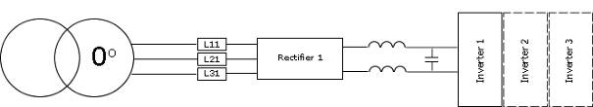
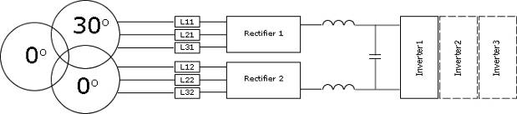
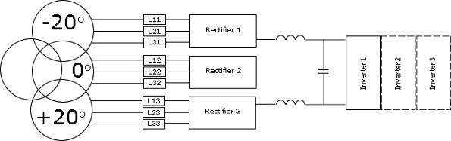
Multi-Pulse Drives
6-pulses
THiD = 30% - 40%
THiD = 12%-15%
12-pulses
THiD = 12%-15%
18-pulses
THiD = 5%-8%

Slide 14
Multi-Pulse Drives
Working Principle
Each Multi-Pulse drive requires a phase shifting transformer but is not required to be dedicated to the drive
Phase shifted Harmonic currents are NATURALLY cancelled at the PRIMARY of the transformer .
All normal 6-pulse harmonic currents are present between the transformer secondary and the drive
Expected THiD
6-Pulse: 30-40%
12-Pulse: 12-15%
18 Pulse: 5-8%
24 Pulse: 4-5%
THiD = 25% - 40%
THiD = ……..

Slide 15
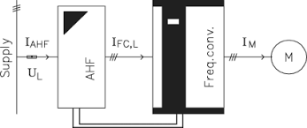
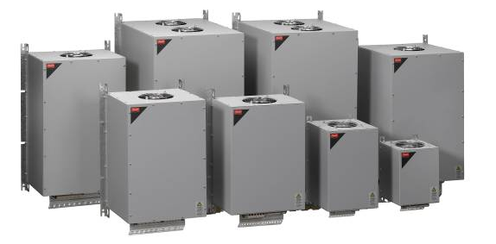
Passive Solutions – Add-on line filters
  Simple design
  Passive components only
    Inductors
    Capacitors
    Resistors
Technology is good for:
  Drive currents <370 A
  Drives loaded 50-100%
  In balanced applications with THDv <5%
  Drive packages <200 kW

Slide 16


Active filters
THiD < 5%
Central compensation
  Easy Retrofit
  Parallel Installation
  Low or medium voltage compensation
Group compensation
  Compensates multiple linear and non linear loads
  Load Independent
  Cannot be overloaded

Slide 17

Active filter
THiD < 5%
An Active Filter is
  Parallel installed device
  Measures the distortion
  Compensates the unwanted currents
  Actively imposing signals in counter phase and so canceling the signal
The results are:
  Remaining current is free of unwanted Harmonic components
  Does not load the transformer
  Increase transformer loading ability
Transformer
CT’s
Load
Active filter
It can be compared to a set of noise cancelling headphones

Slide 18
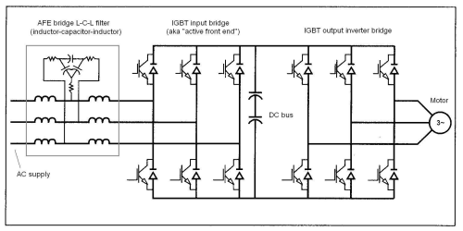
Low harmonic drives based on AFE technology
THiD < 5%
Utilizes Pulse Width Modulation (PWM) also in the rectifier section.
Offers high mitigation performance
Tolerant with load and grid imbalances
Compact design
Good for regeneration of power
Shared DC bus with typically 16% of boost voltage

Slide 19
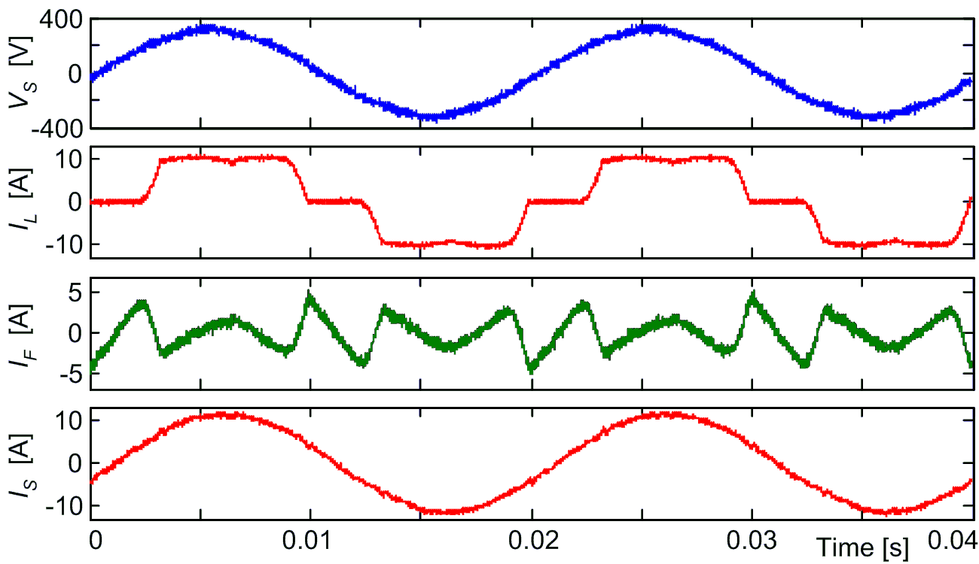
Low harmonic drive based on active filter
THiD < 5%
It is a standard drive coupled with an active filter in the same housing
Offers highest mitigation performance
Tolerant with load and grid imbalances
Better efficiency compared to AFE because the active filter portion is only a fraction of the total drive’s current (about 40%)
No side effects compared to AFE: No du/dt filters are recommended because the DC-link is not shared with the drive’s portion
In case of fault the filter portion can be easily disconnected and the drive portion can still run (with higher harmonics) while waiting for repair
Independent DC bus with 30% of voltage boost

Slide 20
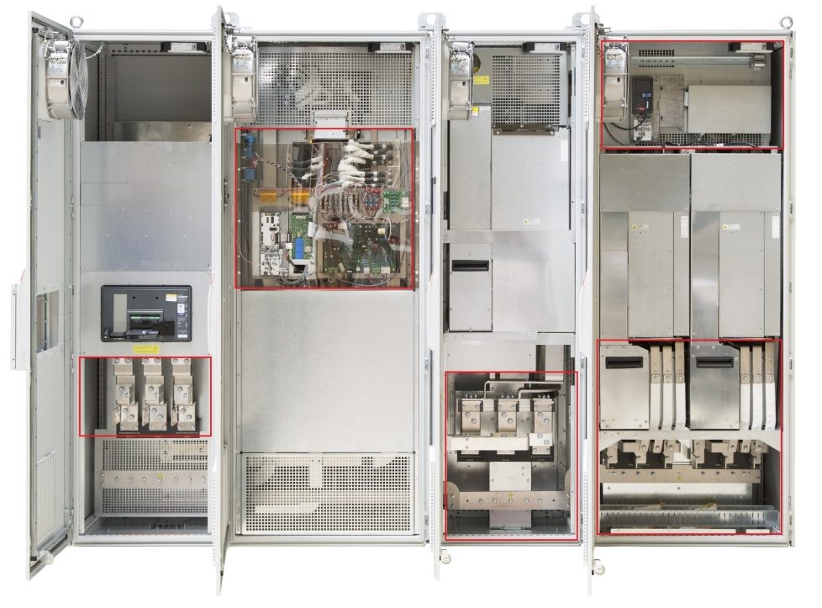
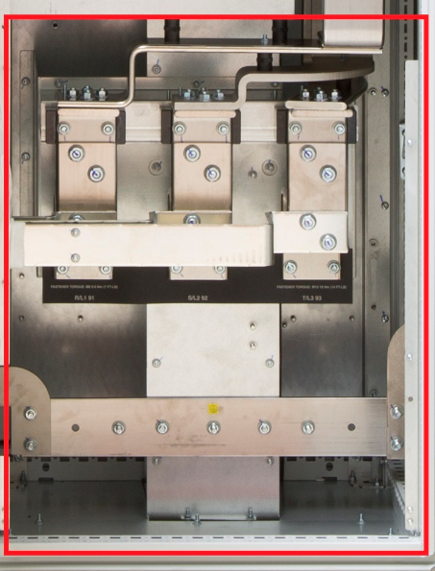
Filter section
Drive section
LHD - Easy disconnection of the filter section in case of power fault
Remove internal bus bars
mains
motor
New mains connection

Slide 21
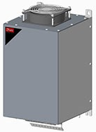

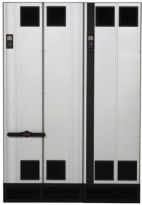
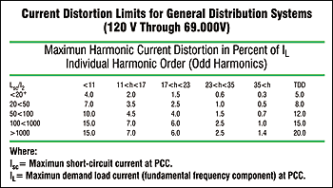
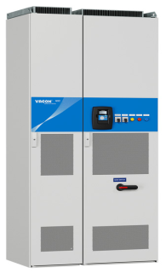
Meeting the IEEE 519
IEEE 519
The IEEE 519 is a system standard and compliance depends also by the network conditions
It’s however very likely that meeting the IEEE 519 is always achievable by using AC drives with mitigation countermeasures to reduce the current harmonic distortion level down to 5% (THDi <= 5%)
Danfoss passive filter AHF 005 + standard 6P drive
IEEE 519
Danfoss Low Harmonic Drive
IEEE 519
Vacon AFE

Slide 22
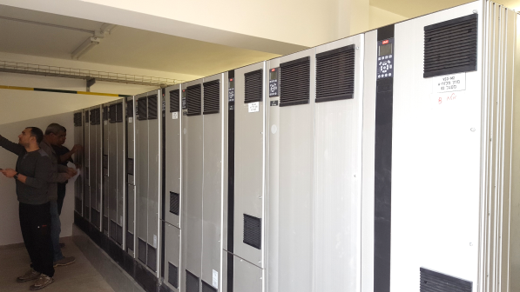
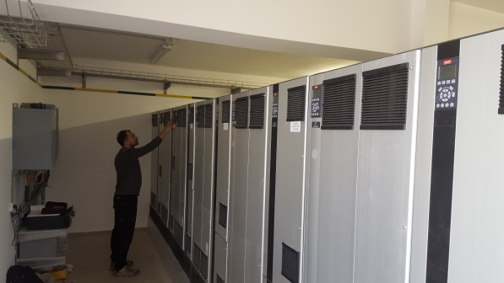
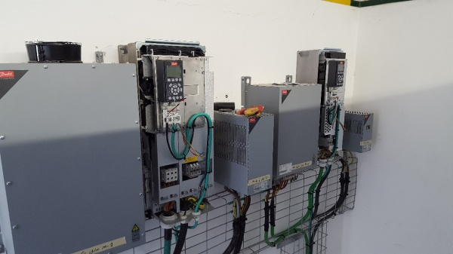
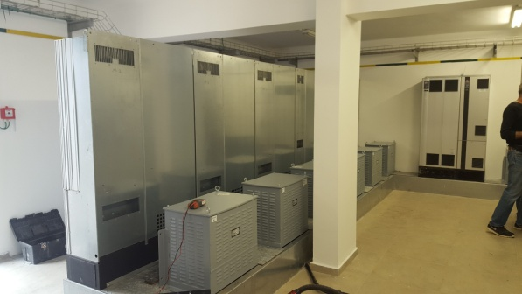
Drives+passive filters and LHDs installed in Israel on a water reservoir plant
Meeting the IEEE 519 by combining multiple solutions

Slide 23
Cost/performance overview
Danfoss/Vacon solutions:
AC or DC coils (as standard)
Add on passive filters (THDi reduction to 5% and 10%)
12/18 Pulses drives
Stand alone active filters
LHD based on active filters (preferred solution when no regeneration is needed)
AFE (when regeneration is needed)

Slide 24
Thank you

